Slide 1
Phase 4: Presentation
By: Michael, Nathan, Sri, and Shawn
(or Group 2)

Slide 2
Overview
Design
Implementation and Testing
Project
and Team Management
Challenges and Lessons Learned
Game, Software, and Architecture
Notes:
Basic overview slide

Slide 3
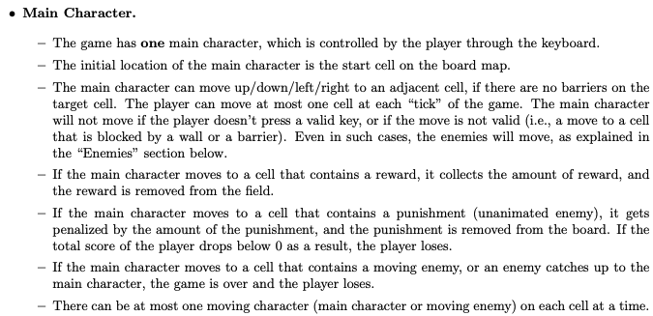
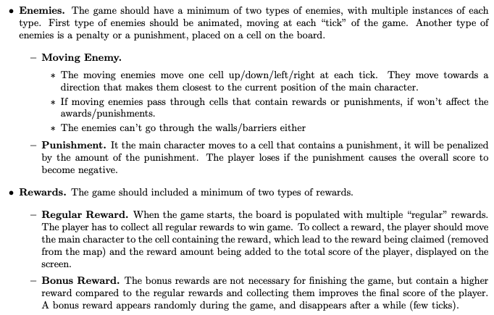
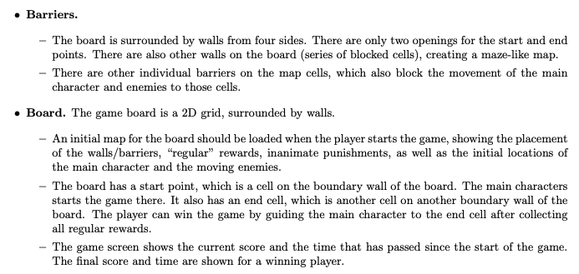
Game Design
Easy requirements engineering?
// TODO: Game Theme
// TODO: Animations
// TODO: Cutscenes
The game is basically done!!!!!
// TODO: Generated Maps
// TODO: ChatGPT???
// TODO: Sound Effects
// TODO: Awesome Trailer
Notes:
Idea behind this slide: Initially gathering requirements was easy because the Phase 1 document had all the basics down. We started thinking about fancy features we could add.

Slide 4

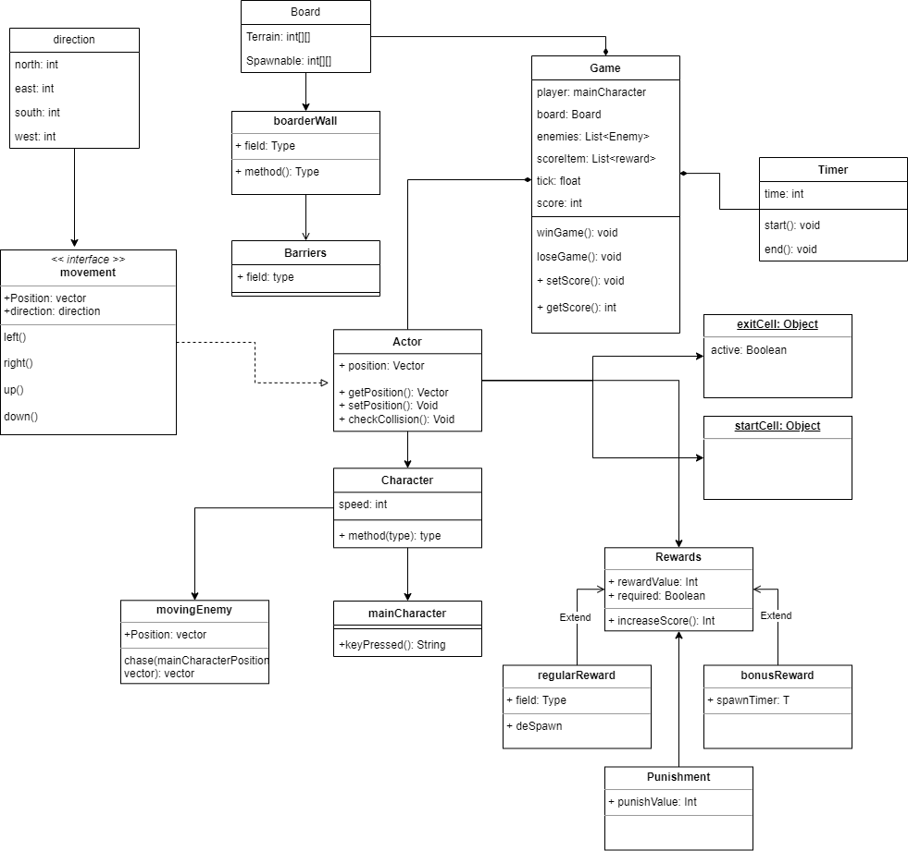
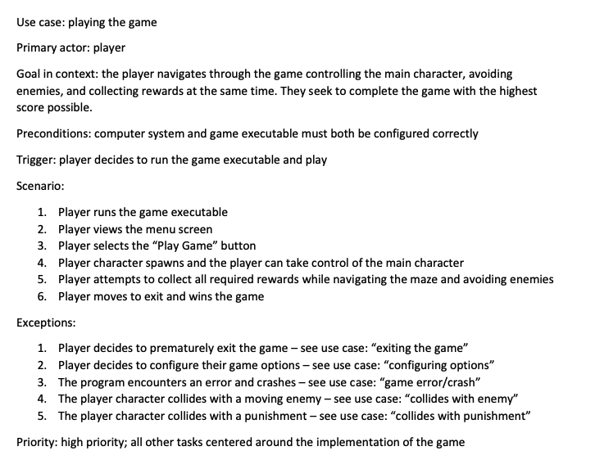
Software Design and Architecture
// Programming Language => Java
// OOP Principles
// UML Diagrams
// Use Cases
Notes:
The programming language we used was Java, utilizing OOP principles. We drew a mock UML diagram to design our software [TALK A BIT ABOUT GENERAL STRUCTURE OF UML]. We wrote use cases to plan out user input.

Slide 5
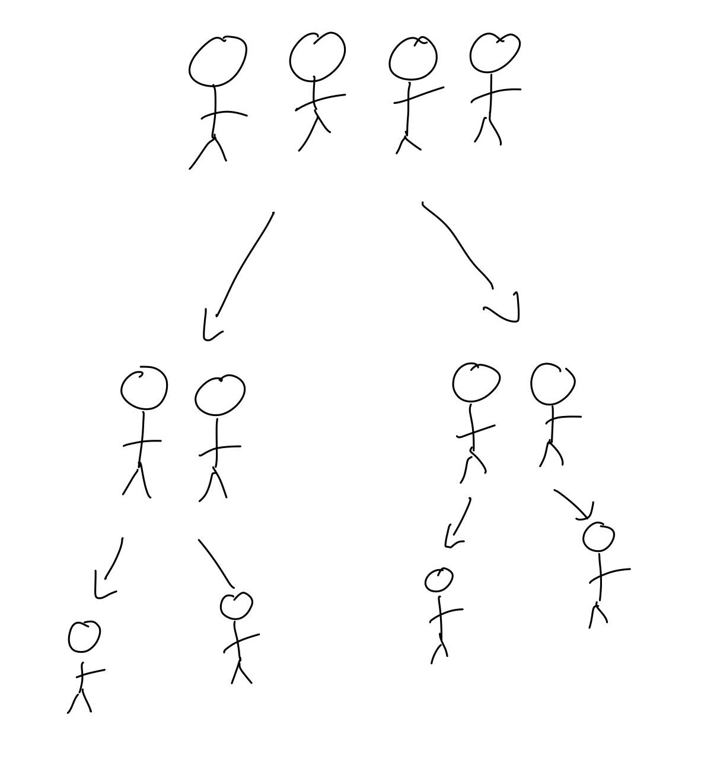
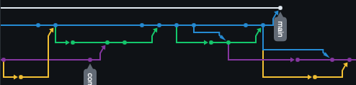
Implementation
// Followed UML diagram exactly
// Pair programmed the parent classes
// Subdivided into smaller teams with subclasses
// Different duties included:
// Map generation
// Character collision
// Animations
// And more!
// Used git for version source control
// Development went on different branches
Notes:
Discuss how we implemented it in a similar way our UML doc was structured, i.e. we broke off as we went down the tree. Appropriate as those implementing subclasses should know about parent class

Slide 6
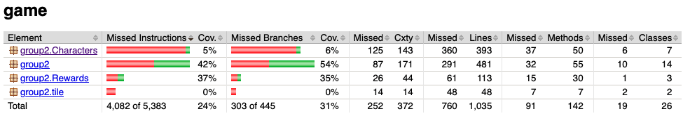
Testing
@ Test
// Unit Tests
// i.e. user input WASD
@ Test
// Integration Tests
// i.e. main character collides with enemy => update score accordingly
@ Test
// Used JUnit + Maven to automate tests
@ Test
// Used JaCoCo to report coverage
Notes:
INSERT IMAGE OF CODE COVERAGE

Slide 7
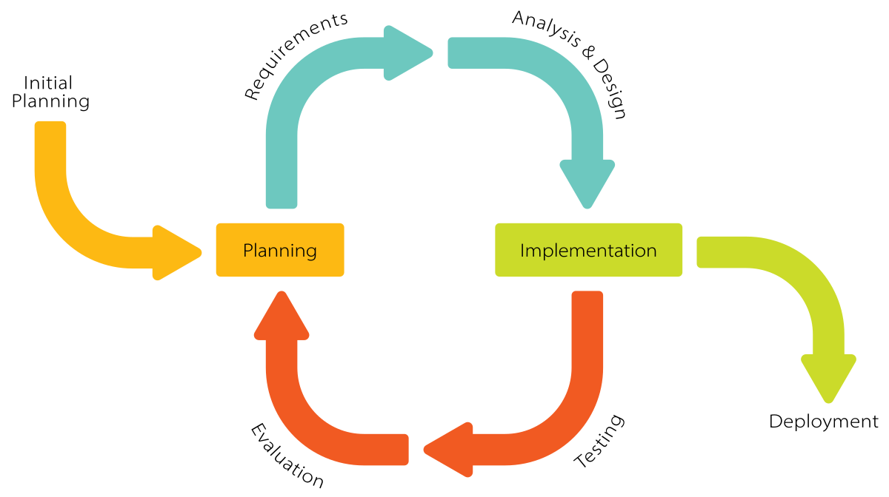
Project and Team Management
// “Incremental + Scrum””-like
// Small increments of software, short weekly meetings
// Longer pair programming sessions as needed
// Duties were assigned based on interest and experience
// As individual’s duties were finished => pivot
// Team members always can help other teammates
// Team members noted down key moments in development
// i.e. major changes to code
// Changes were compiled and added to report

Slide 8
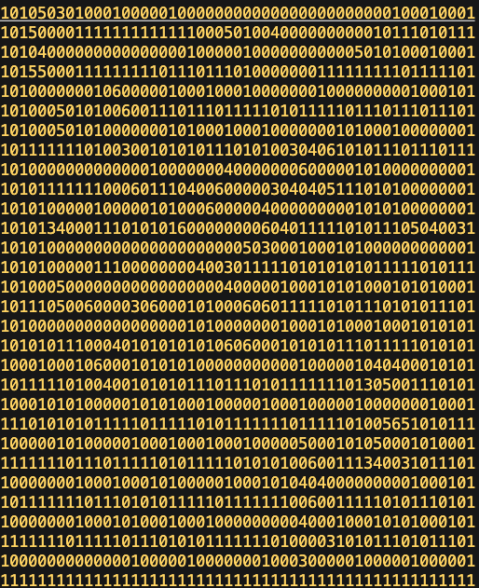
Challenges
// Maze Generation Algorithm
// Recursive division?
// Recursive node creation?
// Recursive backtracking?
// Maze Implementation
// Everyone had different ideas
// No array?
// 1D array?
// 2D array
Notes:
Everybody had different ideas of how collision were gonna work (not necessarily true but good story)

Slide 9
Challenges Part 2
// Collision Logic
// Again everyone had different ideas
// 2D array?
// Box collision?
// Check every frame?
// Spaghetti-code
// Different programming styles
// Altered/unfollowed plans
// Undocumented changes
// Different ideas
// Difficult to help each other!!
// Constant rewrites => messy code
// Difficult to implement other classes
// Unused, unimplemented classes in limbo
// “Wait, we’re not using it?”

Slide 10
“This would be easier
if we could just
start the coding”
Unknown

Slide 11
Lessons Learned
// Don’t just start the coding
// Planning is hugely important!
// Huge amount of time wasted from rewriting code
// Time wasted implementing unused code
// Difficult to help each other
// Don’t assume everyone is automatically on the same page
// Communicate well and often!
// Enforce a standard coding style
// Far easier to read each other’s code and help
// TODO: Don’t procrastinate!

Slide 12
THANKS!
/**
* @return project grade 100%
*/

